Slide 1
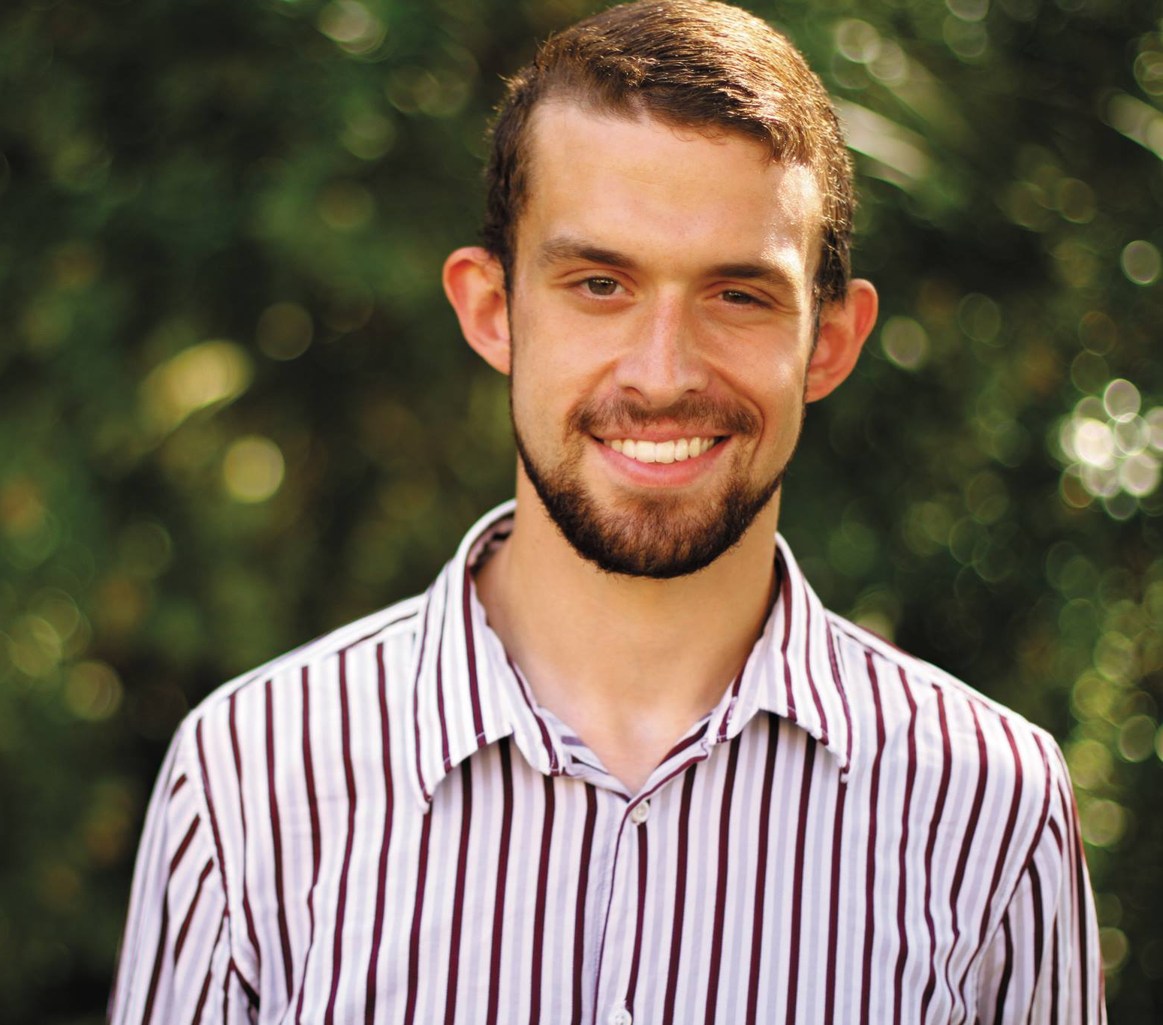
A Life Worth Living and Following
Adam Smelser

Slide 2
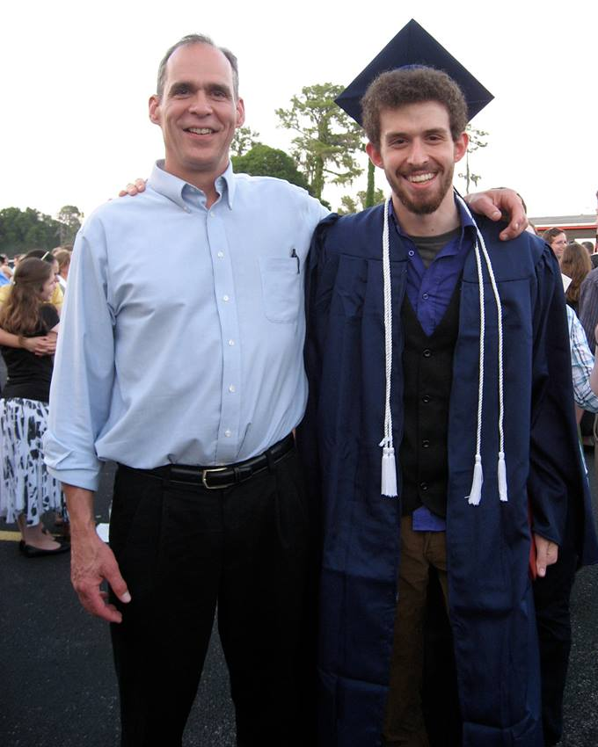
(Sunday, Hours After Finding Out)
Adam’s Dad, Scott, Said:
"Thank you for your prayers. I thank God for my firstborn son, Adam Smelser. I love him and I respect him. I know many of you do too. I am sorry to share with you the grim probability that follows. Adam was last seen leaving his apt. near the river wearing no shoes,
and leaving behind his truck and cell phone. If he'd been going for a run, he would likely have worn shoes (though not always). The lack of shoes points more likely to plans to swim. But about half an hour later after Adam left , witnesses saw a bearded man struggling in the water…

Slide 3
(Sunday, Hours After Finding Out)
Adam’s Dad, Scott, Said:
…Police said there has been a lot of rain, and there are some bad undertows there. A search party was not able to find him. Most telling, when it was time for church, Adam was not back. I am thankful for a son that I know would have been at services. I am
heartbroken for what his absence probably means. I love my son, and I thank my God for him. If somehow he is alive somewhere, I pray to God that he will be safe till he can be found. If not, I want to be with him again someday. I love you Adam. I thank God for you."

Slide 4
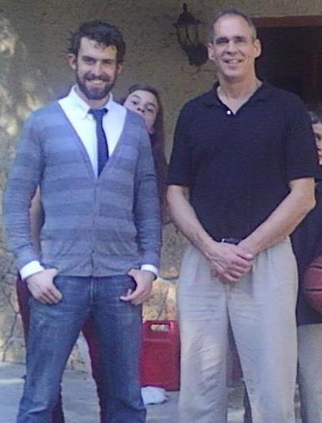
(Monday, the Next Day)
Scott Said:
Yesterday in Bible class here in BG, the teacher spoke of philosophy professors who will challenge students' faith with the question, "Why would God let bad things happen to good people?" Adam raised his hand and said something to the effect of; "This world is a
a broken down and decayed house. My God takes care of us and wants to get us out of that house." I miss you my son. I love and respect you very much. I so wish I could have had more time with you here. I am very thankful for who you are and the 25 years you were here. I keep thanking God for you.

Slide 5
(Monday, the Next Day)
Scott Said:
“After speaking with the police, search team, and Adam's room mates, the heavy facts are as follows: Adam lives near the river, and has spoken at other times to his room mates about swimming in the river. Yesterday it was in the 70's in BG, and after morning
services, Adam headed barefoot without his phone or truck, apparently for another swim in an area he apparently had been in before. Unfortunately, the river was swollen with rain, and the rapids and undertow were more powerful than he realized until too late. He was seen in the water, got stuck

Slide 6
(Monday, the Next Day)
Scott Said:
in an undertow and went under. The search teams continued to look into the night tonight. I am thankful for their efforts. As delirious as I would be with a rescue, the search is focused on recovery.
I am sorry for the pain this brings. I know many people love Adam. He
has been a very special young man of great integrity, and he has brought joy to so many. I hurt for me, and I hurt for you who love him. But I am thankful for the blessing of my son, Adam Brent Smelser. 2 Thess. 4”

Slide 7
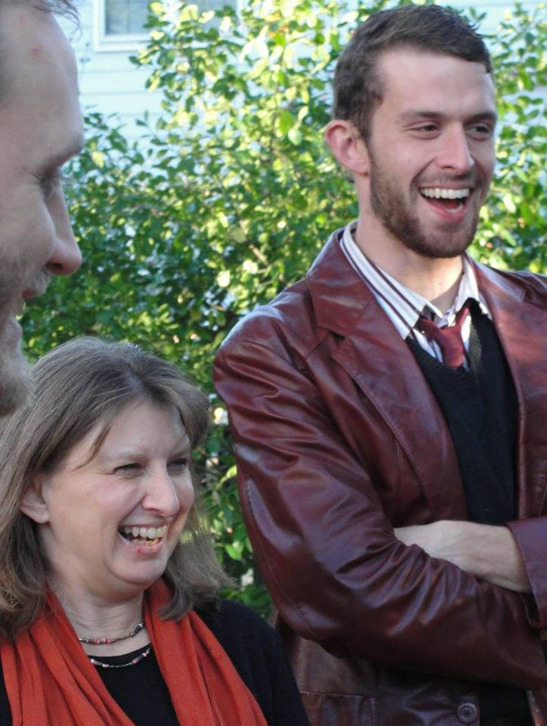
(Monday, the Next Day)
Adam’s Mother, Bertina, Said:
"We are now in Bowling Green Ky where the search efforts are still on. However, at this point we believe it is purely recovery. I am focused on the fact that Adam was a good man who was forgiven of his sins and I will live to meet him with the Lord in heaven at the end.
I am so proud of my big boy. I packed his apt. today and found it very therapeutic to see his simple ways of life. Painting, sewing, reading novels, studying, music and putting God's kingdom first!"

Slide 8
Bertina wanted the following to be told to a gathering at Florida College in Adam’s honor.
Please tell everyone that what Adam would want is for us to do as he told Damon Farris, "remember who you are..." We are pilgrims on a journey to the next life. May this help our focus. Thank you everyone!

Slide 9
Adam’s uncle Jeff sent this message to students praying:
If Adam is alive, God is with him. If he's not alive, then he's with God. Remind everyone that life is short, sometimes shorter than we imagine. Trusting in Jesus means ordering one's life in His way. Remind all those young people on the bridge to do that daily, hourly, constantly.

Slide 10
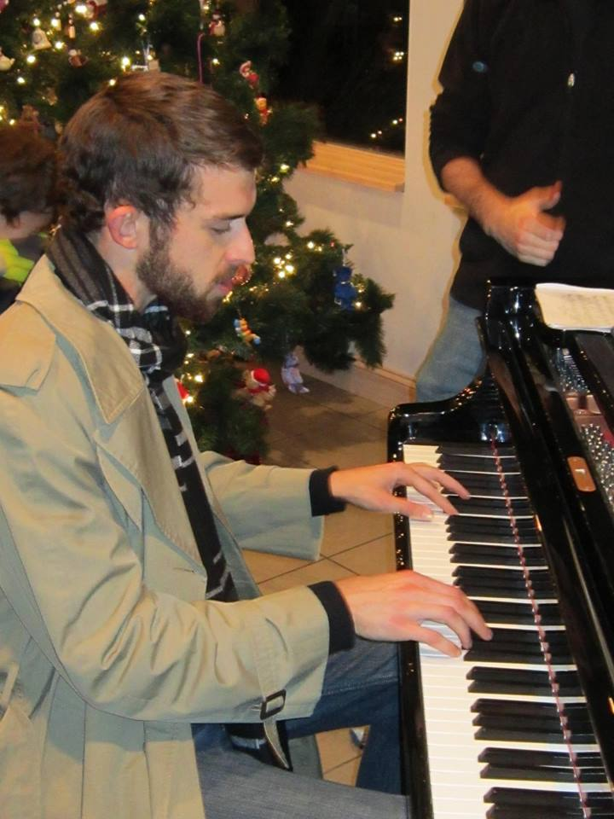
Carlos Peralta’s description of how Adam influenced him is typical of what many others said. Carlos said:
Though in perspective to eternity our days are but a vapor here we often lose perspective of what life under the sun is about. I'm thankful that Adam has reminded me what it is about. I'm reminded that too often I'm ashamed of lowly circumstances, too often I'm not content with what God has given me, too often I'm not joyful with where I am in life but Adam reminds me

Slide 11
Carlos Peralta’s description of how Adam influenced him is typical of what many others said. Carlos said:
that a simple life with The Lord brings more joy and fulfillment than anything else. Too often I waste time in useless things, useless entertainment, and vain relationships but Adam reminds me to cherish the real friendships I have, to love the brothers and sisters God has put in my life and enjoy the real relationships I have with those around me. He would

Slide 12
Carlos Peralta’s description of how Adam influenced him is typical of what many others said. Carlos said:
always keep in touch no matter where he was because he loved the people in his life. He reminds me of the fun and adventure and opportunities to be found in this Earth God as given us. But most of all I'm reminded that this life is about the next and Adam lived his life in that way. As I am thankful that he walks with God I'm reminded that too many people I have

Slide 13
Carlos Peralta’s description of how Adam influenced him is typical of what many others said. Carlos said:
crossed paths with and that I care about don't have the hope we share. Lets be committed to the mission. Adam you finished your race, thanks for helping me run mine.

Slide 14
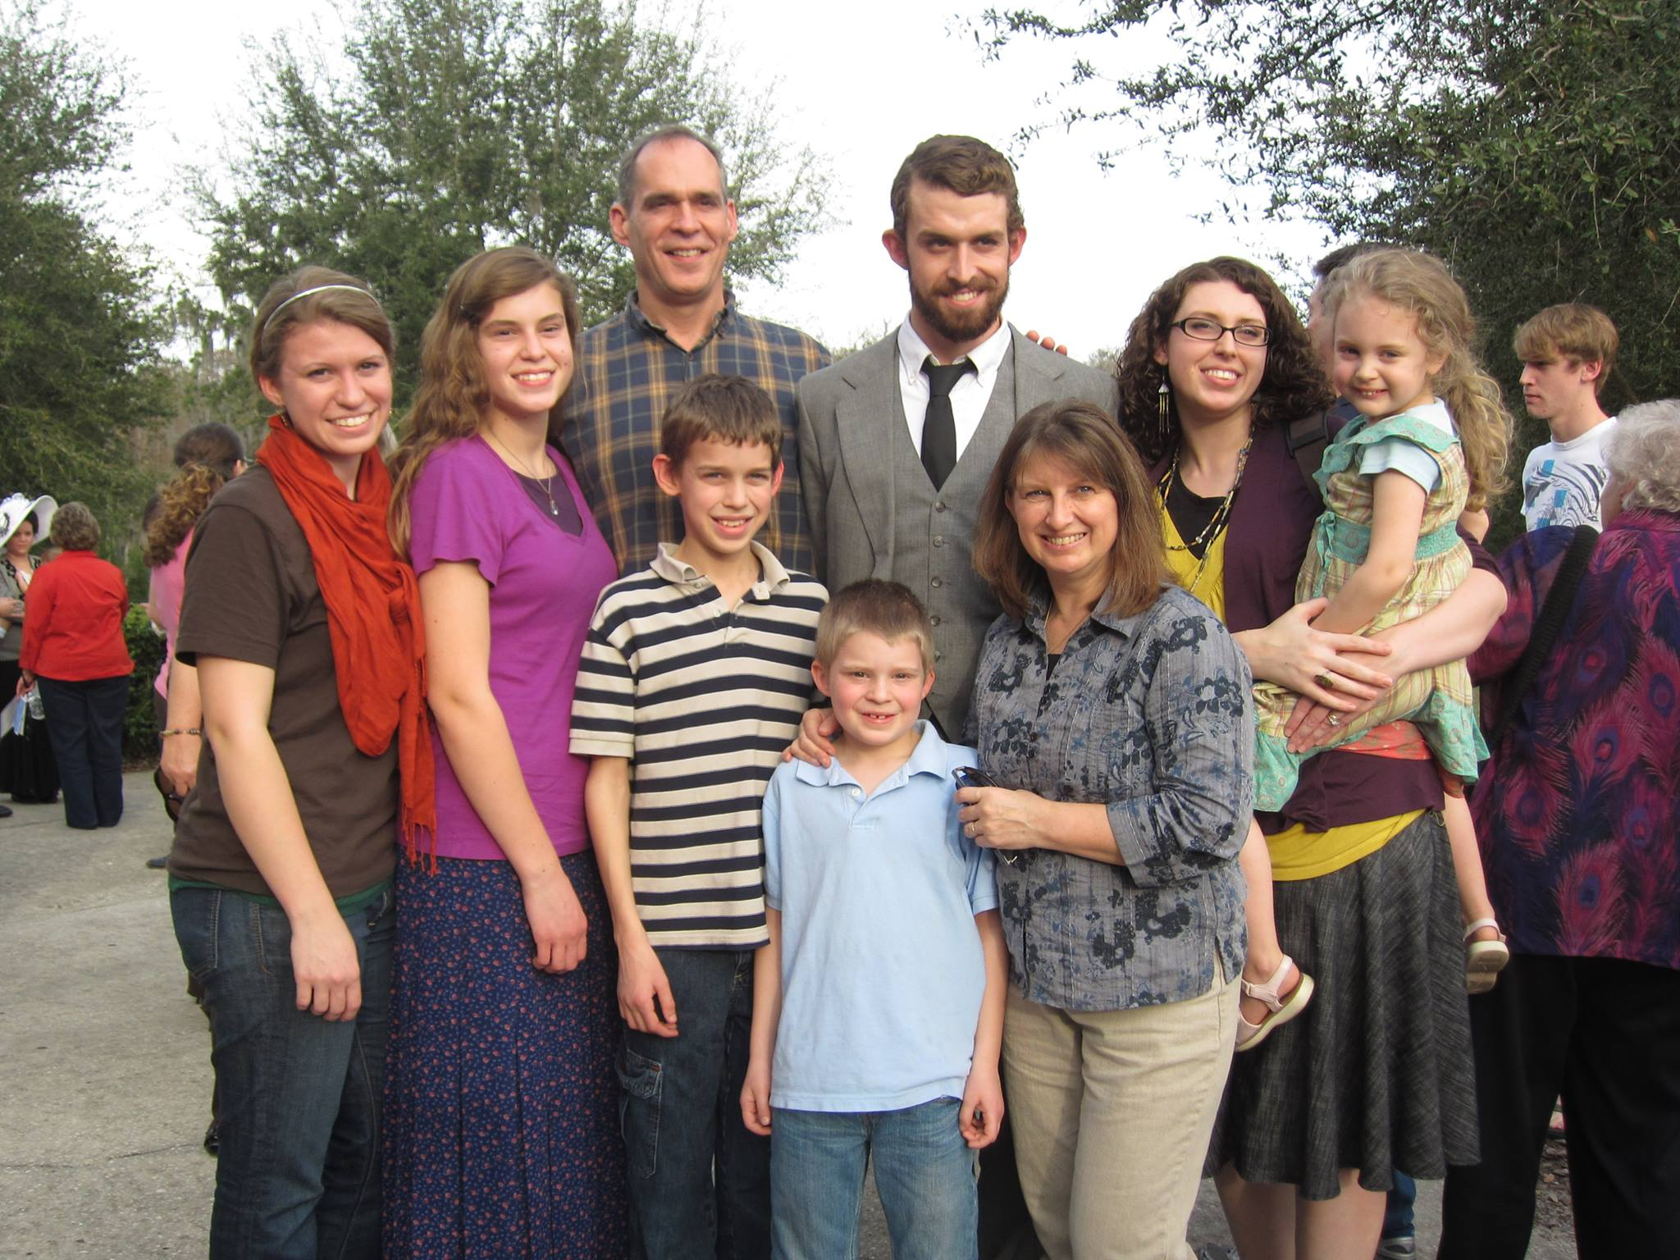
How Does Someone Become Such A Godly Man and Influence for Good by 25 Years Old?
Parents who are focused on the Lord.
Parents who are focused on raising children focused on the Lord.
A heart that humbly accepts the instruction of the Lord.

Slide 15
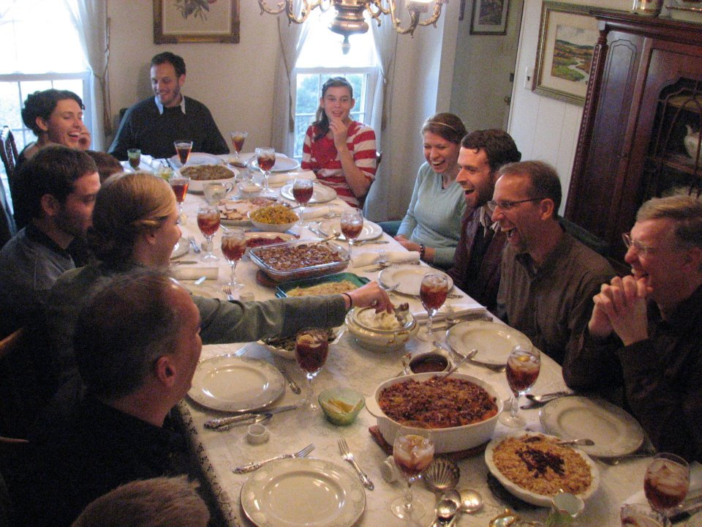
A Smelser Thanksgiving picture Adam’s sister posted a few days before in anticipation of Thanksgiving 2013.
A family who truly loves the Lord can only come through parents who work hard at it, are consistently good examples, and pray fervently about their family!

Slide 16
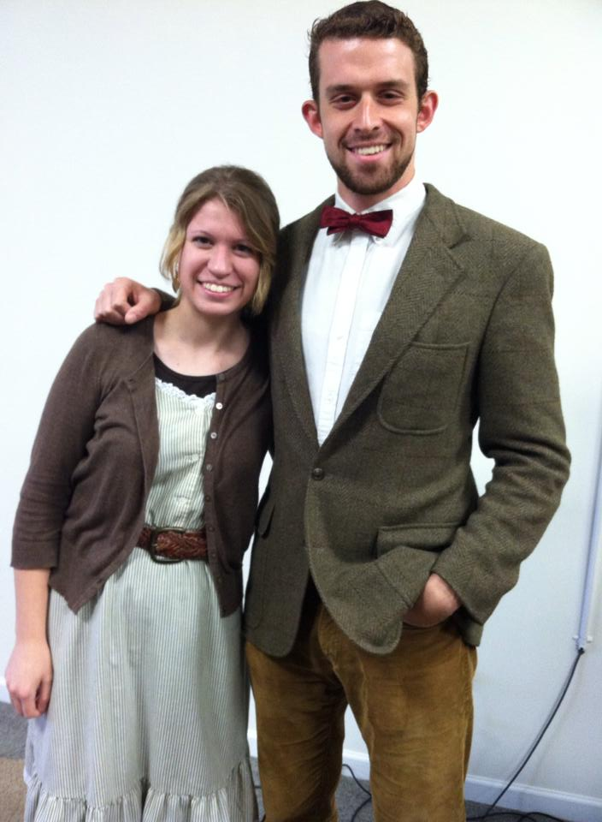
(Three Days Later)
Adam’s sister, Brianne, wrote:
C.S. Lewis once said, "No one ever told me that grief felt so like fear." I used to agree with Lewis' sentiment, but now? Not so much. "No guilt in life, no fear in death, this is the power of Christ in me." I've thought a lot about death the past few months having no idea what the future held.
I came to realize that, for Christians, death is beautiful. Painful, but not fearful. God made it beautiful when He sent His only Son to this broken world. Sin makes death ugly, Jesus' blood cleanses the ugliness and brings us Home. I am

Slide 17
(Three Days Later)
Adam’s sister, Brianne, wrote:
confident that Adam is receiving God's ultimate gift. Although a Christian's death is beautiful, that doesn't mean it does not hurt. Everything about me hurts - my heart, my body, my mind. But "it's better to feel pain, than nothing at all." We cannot bring Adam back to his earthly home, but we
can surely meet him in our Heavenly Home.
I long for just a few more moments with him. I want him to give me one more rib breaking bear hug. I want him to

Slide 18
(Three Days Later)
Adam’s sister, Brianne, wrote:
punch the cookies or muffins I baked. I want him to throw things at me while I'm trying to work. I want him to annoy me. I want to hear his laughter. I want to hear him tell me more about God's word. I want to listen to him play music. Man, I even want to smell him after one of his runs! But as
much as my heart longs for those little comforts, none of them are worth bringing him back to this broken world. That isn't even an option! Therefore, one day, I will join him with our Heavenly Father.

Slide 19
(Three Days Later)
Adam’s sister, Brianne, wrote:
Grief is a fickle friend. It not only pains you because of your loss, but it pains you for the loss of others. My heart aches for each of you - whether you are his relative, his friend, his roommate, his co-worker, or merely someone who has grown to know him only through these posts. All of my
love to you and if I could hug each of you? Well, your necks might be sore. Thank you for showing me God's love through your posts, messages, texts, calls, prayers, and generosity. I realize there is a big difference in being helpful and *feeling*

Slide 20
(Three Days Later)
Adam’s sister, Brianne, wrote:
helpful. But please know - please, please, please know - that you ARE helping. So very much.
And so we face a new reality. And it will be ok, just a different ok. I praise God for the impact Adam had on so many and I pray He continues to use his death to bring others closer and more dedicated to Him. The Lord gave, and the Lord has taken away,
but He has never given us anything we cannot handle. He is able and is providing. I now realize he provided me with a big brother who has helped me prepare to go Home in ways I never expected. Glory to God.

Slide 21
Scott, trying to encourage others struggling with the death of Adam, said:
A few thoughts, and maybe a few answers to some questions. Those of you who know Adam, know his zeal for God. You also know his goodness to others. You also know he was independent and adventurous. He went to Alaska, slept in the woods, and was probably a bit disappointed in the lack of bears in the area. He lived in Texas in a garage without heat or AC. He made his own bed, tables, and shelves from scrap lumber. He worked hard, and lived frugally but with zest. His apt. had a few gifts from us, a recent letter from Brianne, his song book, his Bible, his school books, his running shoes, his harmonicas and guitar. He enjoyed painting, sewing (this was news to me) and exercise. He was a strong young man, and kept himself fit. His choice of swimming hole was apparently

Slide 22
Scott, trying to encourage others struggling with the death of Adam, said:
to workout by swimming against the current coming off the rapids. He had apparently done it before, but at times when the river level was lower. He did not realize the danger of the undertow as a result of recent rain.
Do I wish God had intervened? Of course I do. My heart is broken. I miss my son, and wish I could have saved him. I wish I could tell him how much I admire him. I wish I could see what else this courageous and talented young man would do. But is it God's job - in this world below - to always intervene and save us from every illness? From every threat? From the laws of nature and physics? He can intervene. He saved Peter in Acts 12. But he didn't for James. Paul was spared when he was stoned, but Stephen was not. But both would face

Slide 23
Scott, trying to encourage others struggling with the death of Adam, said:
difficult deaths later.
Late Saturday night, I told Bertina that we needed to enjoy the times we have, and that someday tragedies will strike us. I prayed, and we thanked God for our 3 boys and our 3 girls. I prayed for their safety – We do not get everything we pray for. Saints prayed for Peter's safety in Acts 12, and he was delivered. But I'm sure they prayed for James a few days before. Not all wishes are granted, else we would have a world full of very healthy, very ancient brethren. We have all have loved ones die that we prayed for. But another thought is this: God's definition of safe goes beyond this life.
Emma Bingham wrote that she had been fervently praying,

Slide 24
Scott, trying to encourage others struggling with the death of Adam, said:
“God save Adam, God save Adam.” Then she realized, God has already SAVED ADAM.
I read this morning that another comment Adam made in Bible class Sunday morning, was to the effect: "We are not made for this world.” My son's wisdom and zeal comfort me greatly. Do not mistake this to mean I am not suffering. Any father knows better. I am crying as I write this. But my son made these insights in Bible class, assembled with saints for worship, sang, prayed, and partook of the Lord's Supper. Then he went home, and went out for a swim. Alone. In a faster current than usual.
That means that he won't finish some of his earthly goals.

Slide 25
Scott, trying to encourage others struggling with the death of Adam, said:
He will not do his research experiment. He will not finish school. He will not begin his career. But these were side goals for Adam. His CHIEF goal was seeking the kingdom of God, and his righteousness. Rejoice in that for him. I thank God for Adam, and want to be more like him.
He is my hero.

Slide 26
When the body was found on Thursday,
Scott wrote:
Thankful. Jesus saved Adam’s soul and
Warren County Rescue Department has found the shell.

Slide 27
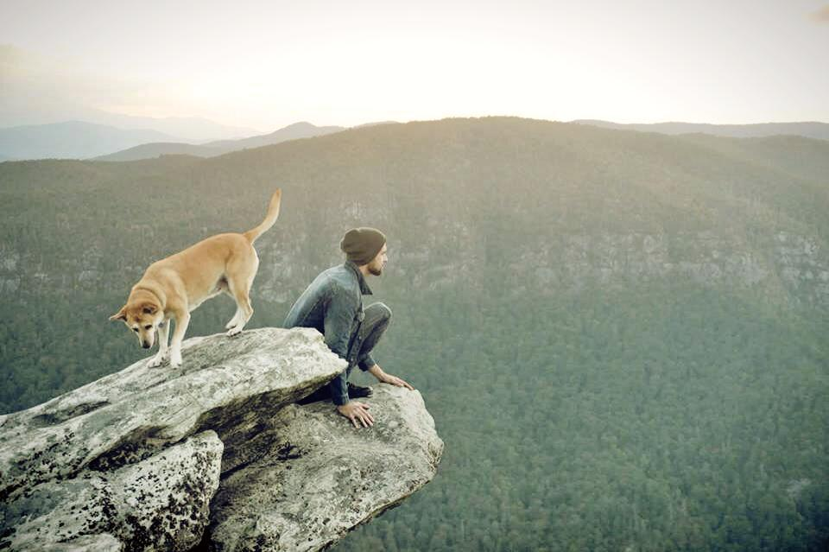
Psalm 121
¹ I will lift up my eyes to the mountains; From where shall my help come? ² My help comes from the Lord, Who made heaven and earth. ³ He will not allow
your foot to slip; He who keeps you will not slumber. ⁴ Behold, He who keeps Israel Will neither slumber nor sleep. ⁵ The Lord is your keeper; The Lord is your shade on your right hand. ⁶ The sun will not smite you by day, Nor the moon by night. ⁷ The Lord will protect you from all evil; He will keep your soul. ⁸ The Lord will guard your going out and your coming in From this time forth and forever.

Slide 28
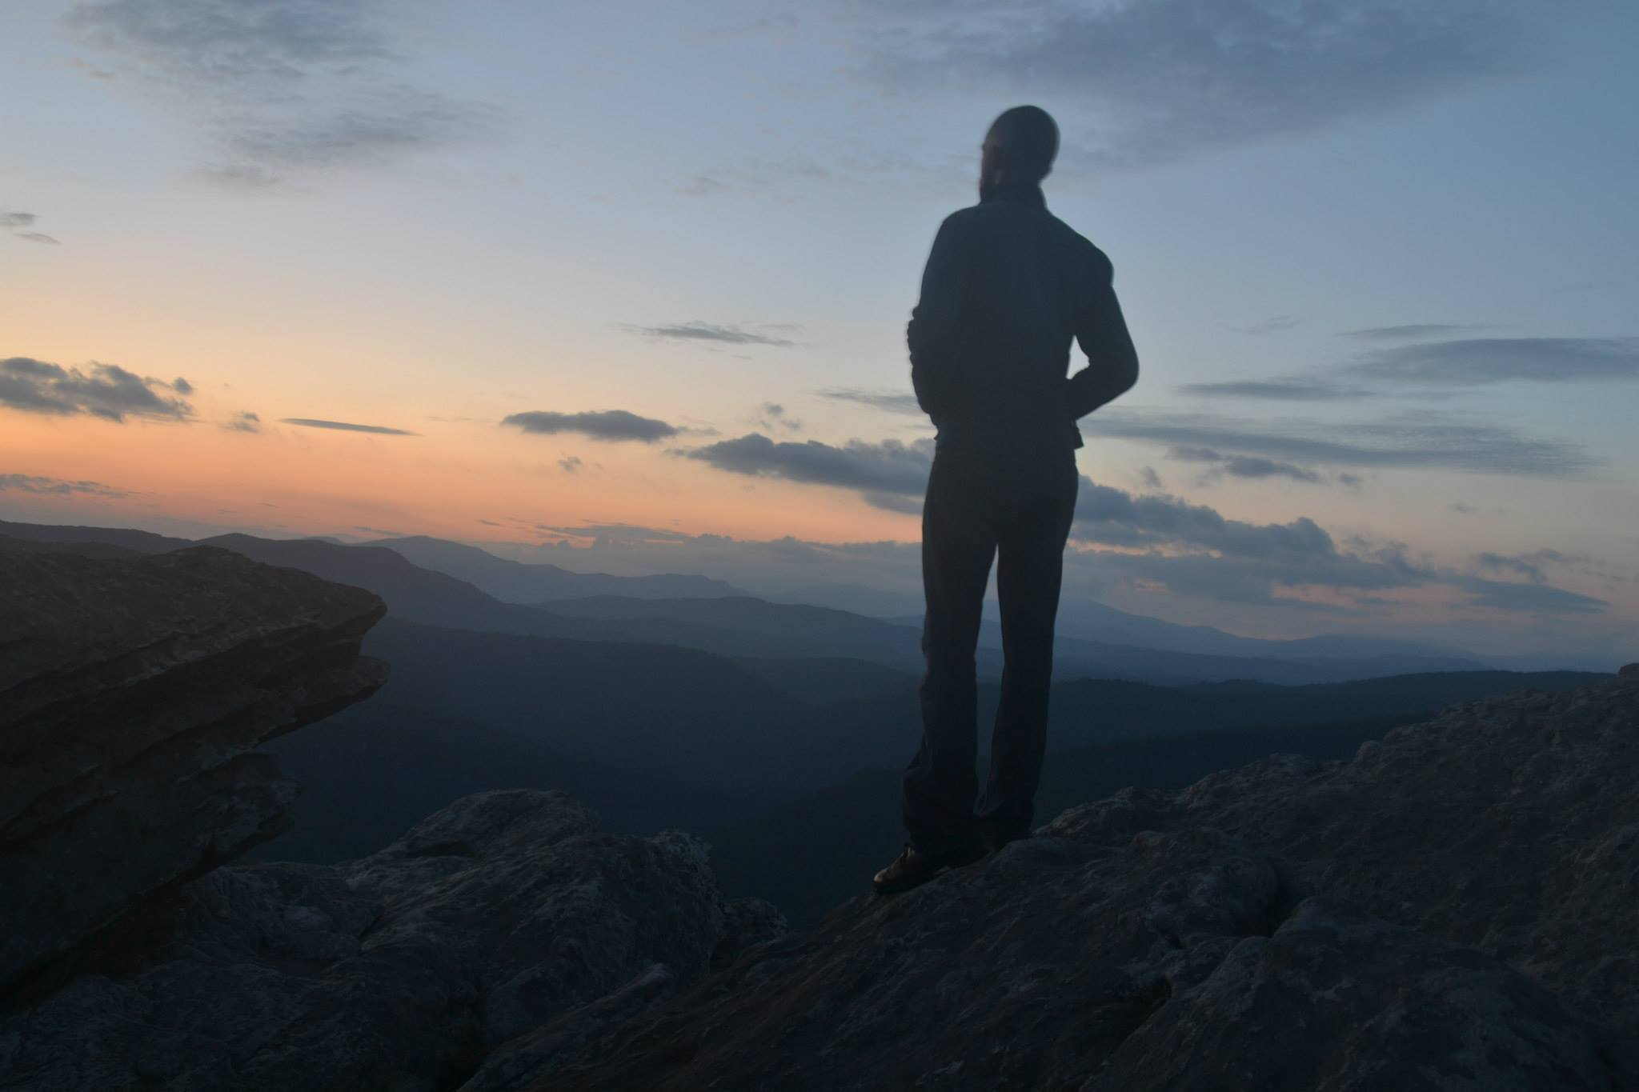
Sara Focht wrote:
"Thus says the Lord: A voice is heard in Ramah, lamentation and bitter weeping. Rachel is weeping for her children; she refuses to be comforted for her
children, because they are no more. Thus says the Lord: keep your voice from weeping, and your eyes from tears, for there is a reward for your work, declares the Lord, and they shall come back from the land of the enemy. There is hope for your future, declares the Lord, and your children shall come back to their own country." (Jeremiah 31:15-17)

Slide 29
Sara Focht wrote:
God be with you in your time of grief, dear Smelser family. Our hearts ache for you. We know that your beloved son has been taken back to his "own country".
"I will turn their mourning into joy; I will comfort them and give them gladness for sorrow" (Jeremiah 31:13).

