Slide 2


“Mind Your
Own Business”

Slide 3


“No Really,
Mind Your Own Business”

Slide 4
“No Really,
Mind Your Own Business”

Slide 5
“No Really,
Mind Your Own Business”

Slide 6

“Mind Your Own Business” 1 Thess.4:11
“that you also aspire to lead a quiet life, to mind your own business, and to work with your own hands, as we commanded you,” 1 Thess.4:11

Slide 7
“Mind Your Own Business” 1 Thess.4:11
Be Observant
Be Deliberate
Be Careful

Slide 8
“Mind Your Own Business” 1 Thess.4:11
Be Observant
Learn from mistakes or successes.

Slide 9

2 Corinthians 13:5
Examine yourselves as to whether you are in the faith. Test yourselves. Do you not know yourselves, that Jesus Christ is in you?—unless indeed you are disqualified.

Slide 11
“Mind Your Own Business” 1 Thess.4:11
Be Observant
Learn from mistakes or successes.
Self-awareness, a gift.

Slide 13
“Mind Your Own Business” 1 Thess.4:11
Be Observant
Learn from mistakes or successes.
Self-awareness, a gift.
Notice consequences!

Slide 14
Deuteronomy 32:29
Oh, that they were wise, that they understood this,
That they would consider their latter end!

Slide 15
Proverbs 14:8–9 (ESV)
The wisdom of the prudent is to discern his way,
but the folly of fools is deceiving.
Fools mock at the guilt offering,
but the upright enjoy acceptance.
Notes:
8 “This is not self-deceit, which the word does not denote, but deceit of others.”
9 “Fools, wicked men, commit sin lightly and cheerfully, give specious names to grievous transgressions, pass over rebuke with a joke, encourage others in crime by their easy way of viewing it. … , “Sin mocks fools,” i.e. deceives and disappoints them of the enjoyment which they expected.”
Spence-Jones, H. D. M. (Ed.). (1909). Proverbs (p. 269). London; New York: Funk & Wagnalls Company.
Spence-Jones, H. D. M. (Ed.). (1909). Proverbs (p. 269). London; New York: Funk & Wagnalls Company.

Slide 17
“Mind Your Own Business” 1 Thess.4:11
Be Observant
Learn from mistakes or successes.
Self-awareness, a gift.
Notice consequences!
Observe yourself!

Slide 18
Proverbs 4:26
Ponder the path of your feet,
And let all your ways be established.
Notes:
Ver. 26.—Ponder the path of thy feet; properly, make straight or level the path of thy feet. The command carries on the idea of the previous verse. Simplicity of aim in the moral life is to be accompanied by attention to the moral conduct. The sense is, remove every obstacle which may impede or render insecure the way of moral life, and thus avoid every false step. …Weigh your conduct as in a balance; before acting, consider the consequences and nature of the act.”
Spence-Jones, H. D. M. (Ed.). (1909). Proverbs (p. 92). London; New York: Funk & Wagnalls Company.
,”
Spence-Jones, H. D. M. (Ed.). (1909). Proverbs (p. 92). London; New York: Funk & Wagnalls Company.

Slide 19
“Mind Your Own Business” 1 Thess.4:11
Be Observant
Be Deliberate
Be Careful

Slide 20
“Mind Your Own Business” 1 Thess.4:11
Be Observant
Be Deliberate
Be Careful

Slide 21
“Mind Your Own Business” 1 Thess.4:11
Be Deliberate
Quality is chosen.

Slide 22
Joshua 24:15
And if it seems evil to you to serve the Lord, choose for yourselves this day whom you will serve, whether the gods which your fathers served that were on the other side of the River, or the gods of the Amorites, in whose land you dwell. But as for me and my house, we will serve the Lord.”

Slide 23
1 Kings 18:21
And Elijah came to all the people, and said, “How long will you falter between two opinions? If the Lord is God, follow Him; but if Baal, follow him.” But the people answered him not a word.

Slide 24
“Mind Your Own Business” 1 Thess.4:11
Be Deliberate
Quality is chosen.
Stop living haphazardly, randomly.

Slide 26
“Mind Your Own Business” 1 Thess.4:11
Be Deliberate
Quality is chosen.
Stop living haphazardly, randomly.
Be deliberate!

Slide 27
Proverbs 4:23
Keep your heart with all diligence,
For out of it spring the issues of life.

Slide 28
Luke 10:42
“But one thing is needed, and Mary has chosen that good part, which will not be taken away from her.”

Slide 29
“Mind Your Own Business” 1 Thess.4:11
Be Observant
Be Deliberate
Be Careful

Slide 30
“Mind Your Own Business” 1 Thess.4:11
Be Observant
Be Deliberate
Be Careful

Slide 31
“Mind Your Own Business” 1 Thess.4:11
Be Careful
Life requires caution and carefulness

Slide 32
1 Corinthians 10:12
Therefore let him who thinks he stands take heed lest he fall.

Slide 33
“Mind Your Own Business” 1 Thess.4:11
Be Careful
Life requires caution and carefulness
Caring enough to work at quality living.

Slide 34
Proverbs 22:9
He who has a generous eye will be blessed,
For he gives of his bread to the poor.

Slide 35
Romans 12:11
not lagging in diligence, fervent in spirit, serving the Lord;

Slide 36
“Mind Your Own Business” 1 Thess.4:11
Be Careful
Life requires caution and carefulness
Caring enough to work at quality living.
Walk circumspectly

Slide 37
Ephesians 5:15
See then that you walk circumspectly, not as fools but as wise

Slide 38
“Mind Your Own Business” 1 Thess.4:11
Be Observant
Be Deliberate
Be Careful

Slide 39
Galatians 6:4-5
⁴ But let each one examine his own work, and then he will have rejoicing in himself alone, and not in another. ⁵ For each one shall bear his own load.

Slide 40
1 Timothy 4:15-16
¹⁵ Meditate on these things; give yourself entirely to them, that your progress may be evident to all. ¹⁶ Take heed to yourself and to the doctrine. Continue in them, for in doing this you will save both yourself and those who hear you.

Slide 41
“Mind Your Own Business” 1 Thess.4:11
Be Observant
Be Deliberate
Be Careful

Slide 42
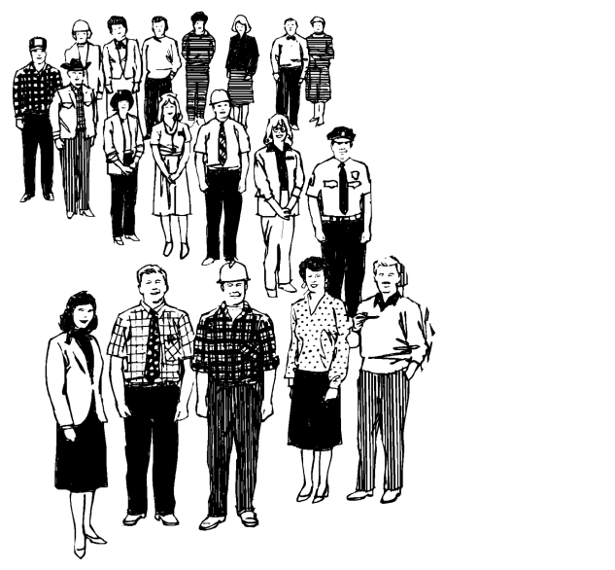
How do we first enter the Light?
Walking in darkness Romans 3:23; 6:23
Hear God’s Grace given Ephesians 2:8
Believe in Jesus as Christ John 3:16
Repent (turn to Jesus)
Acts 2:38
Confess Jesus
Acts 8:37
Baptized to wash away sins Acts 22:16
1 John 1:7
But if we walk in the light, as he is in the light, we have fellowship one with another, and the blood of Jesus Christ his Son cleanseth us from all sin.

Slide 43
How do we first enter the Light?
Walking in darkness Romans 3:23; 6:23
Hear God’s Grace given Ephesians 2:8
Believe in Jesus as Christ John 3:16
Repent (turn to Jesus)
Acts 2:38
Confess Jesus
Acts 8:37
Baptized to wash away sins Acts 22:16

