Slide 1
Home Improvement
(through application of biblical principles)
Foundation / priorities / principles
Being better husbands & wives
Early child training & Parenting Pitfalls (a.)
Child training & Parenting Pitfalls (b.)
Child training & Parenting Pitfalls (c.)
Young people: planning ahead & aiming high

Slide 2
What kind of homes do our children need?

Slide 3
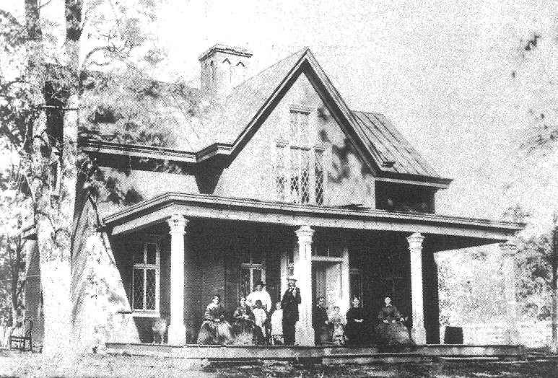
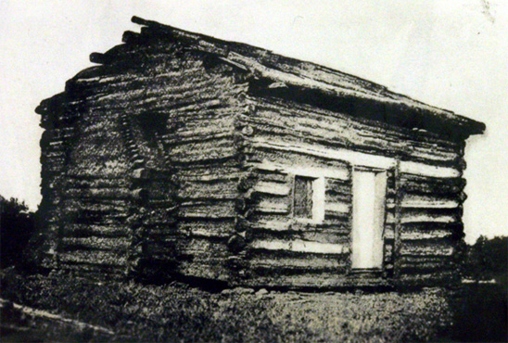

Slide 4
The crying need in our culture is not better houses… it’s better homes.

Slide 5
Gen.2:24
“Let marriage be had in honor among all and let the bed be undefiled, for fornicators and adulterers God will judge.” Heb.13:4
important for the children, the family, society, and the kingdom

Slide 6
“disposable-marriage” in a disposable culture
“I think God wants me to be happy”
“I thought things would be different”
“I want to do what I want to do”
“It’s not good for the kids to see us unhappy”
“I’m not in love anymore”
Luke 16.18; Mark 10; Matt. 19
Malachi 2:13-16
Statistics & NM Judge’s article on divorce

Slide 7
Heb. 13:4
“ Let marriage be had in honor”
Gen.2:24

Slide 8
not just…
“we go to
church”
Deut. 6:4-8
Eph. 6:4

Slide 9
PRIORITIES
Josh. 24:15

Slide 10
How easy it is to overvalue that which is worth less,
& undervalue that which is worth more
Luke 12.13-21
Matt.
16-26

Slide 11
Proverbs
15:16-17
&
17:1

Slide 12
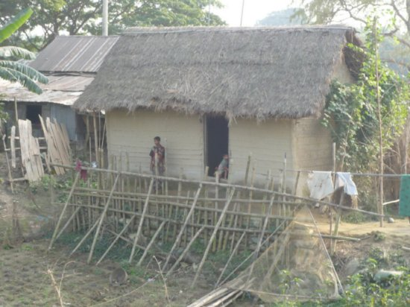
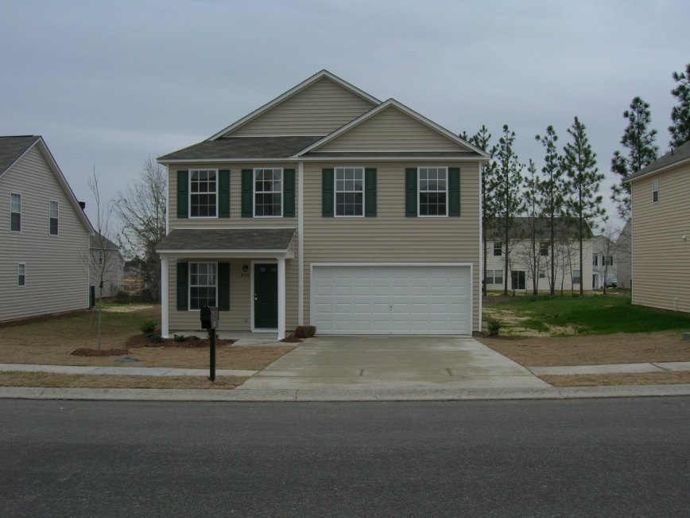


Slide 13
2 Ptr. 3
“seeing that all these things shall be dissolved…”

Slide 14
1Tim.
6:6-10

Slide 15
the relative importance of temporary threats & eternal threats
cf. Mt.
10:28

Slide 16
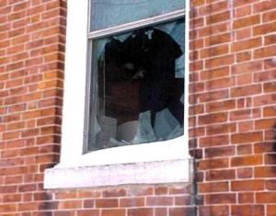
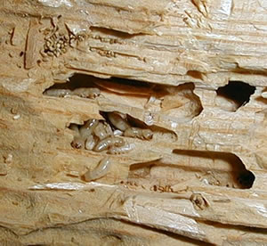
What would I do …?

Slide 17
What would I do …?
If I found our well was toxic?
If I found the city water lines were poisoned?
If I found a gas line was leaking?
If I found your children eating out of the neighbors’ trash?

Slide 18
on a spiritual & moral level…
…am I letting toxic filth infiltrate my home?

Slide 19
The Homes We Need
Built with the Lord
Ps. 127:1
Built on the word
Mt. 7:24-27
Built in sanctification
Josh. 24:15; Deut. 6:4-9; James 4:4

Slide 20
Godliness does not come from taking our cues from the world
Rm.12.1-2

Slide 21
PRINCIPLES
LOVE
Matt.22.37-40; Eph.5.25;
Titus 2.4; Pr.13.34; Pr. 5

Slide 22
PRINCIPLES
ROLES
Josh. 24.15
Eph.5.25; 1Ptr. 3; Eph.6

Slide 23
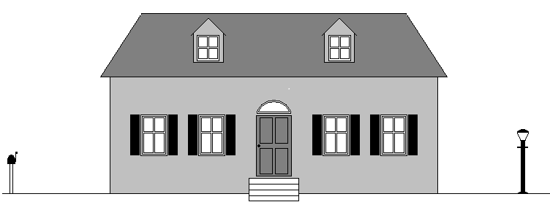
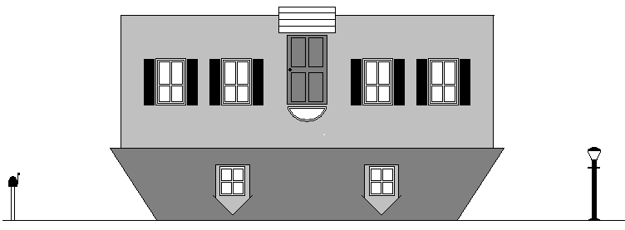
The structure of the family: a.) God Gen.1&2; Dt. 6.4-9; Josh.24.15; Matt.7.24-27 b.) the husband & father Eph.5; Col. 3 c.) the wife & mother Eph.5; 1 Ptr. 3; 1 Tim.5 d.) the children Ps.127:3-5; Eph.6:1-3

Slide 24
UPSIDE DOWN HOMES (M.&.D.Pearl?)
Child centered homes vs. God centered homes:
Too many children view the home, the parents, the food, etc., as merely a means to an ends: to satisfy and please the child.
The child makes his demands and manipulates the parents via tantrums and repeated misbehavior.
Parents bow to the will of the child in efforts to placate and appease his whims and dissatisfactions, or suffer through increased strife and conflict when they cannot.
The home is like a house built upside down.

Slide 25
The child needs to understand:
CHILD
PARENTS
GOD
GOD
father
mother
child

Slide 26
lastly…

Slide 27
the home –
as a castle
as an inn
as a training ground
as a house of God
as a haven of love & joy

Slide 28

Josh 24:15 b

